Slide 1
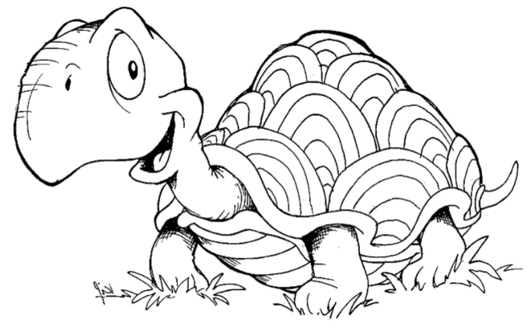
An introduction to Logo
Mike Warriner
Engineering Director, Google
Note: This course is not an endorsement of Logo by Google. All views in this document are solely those of the author.

Slide 2
Who am I?

Slide 3
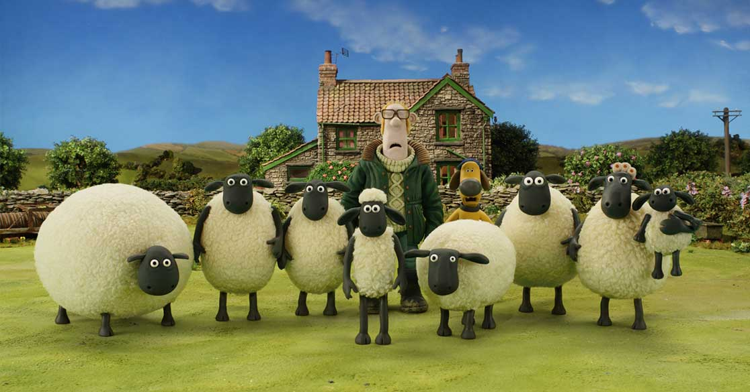

Slide 4
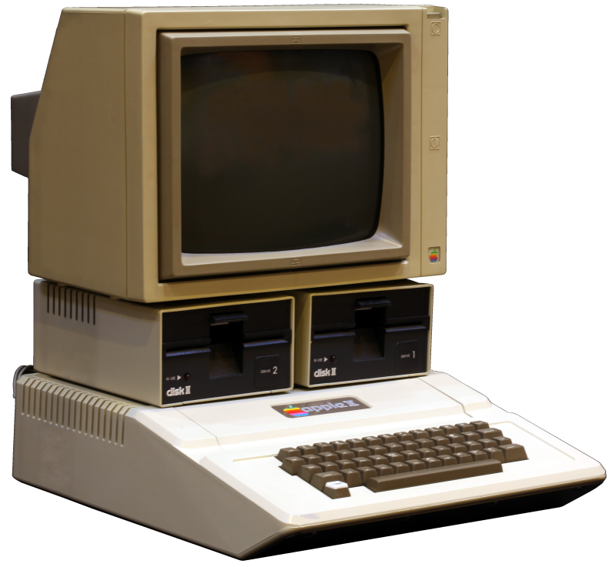

Slide 5
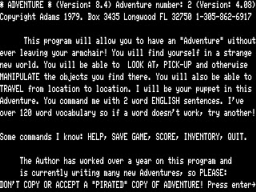

Slide 6
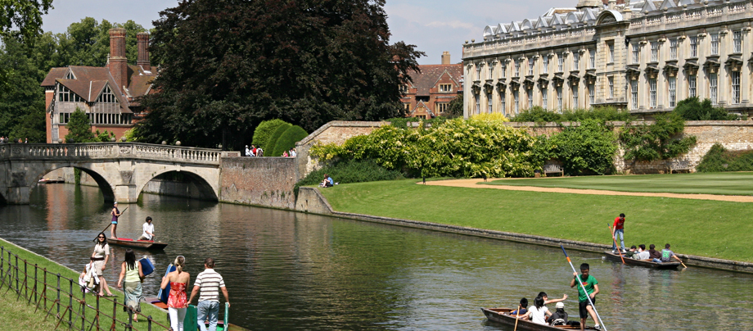

Slide 7


Slide 8
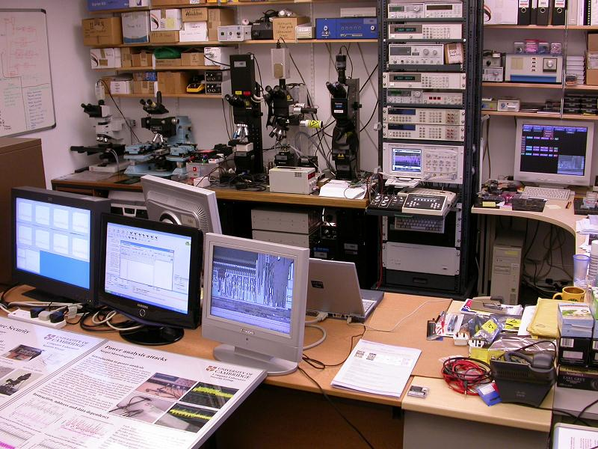

Slide 9
A bit about Google
Google Confidential and Proprietary

Slide 10
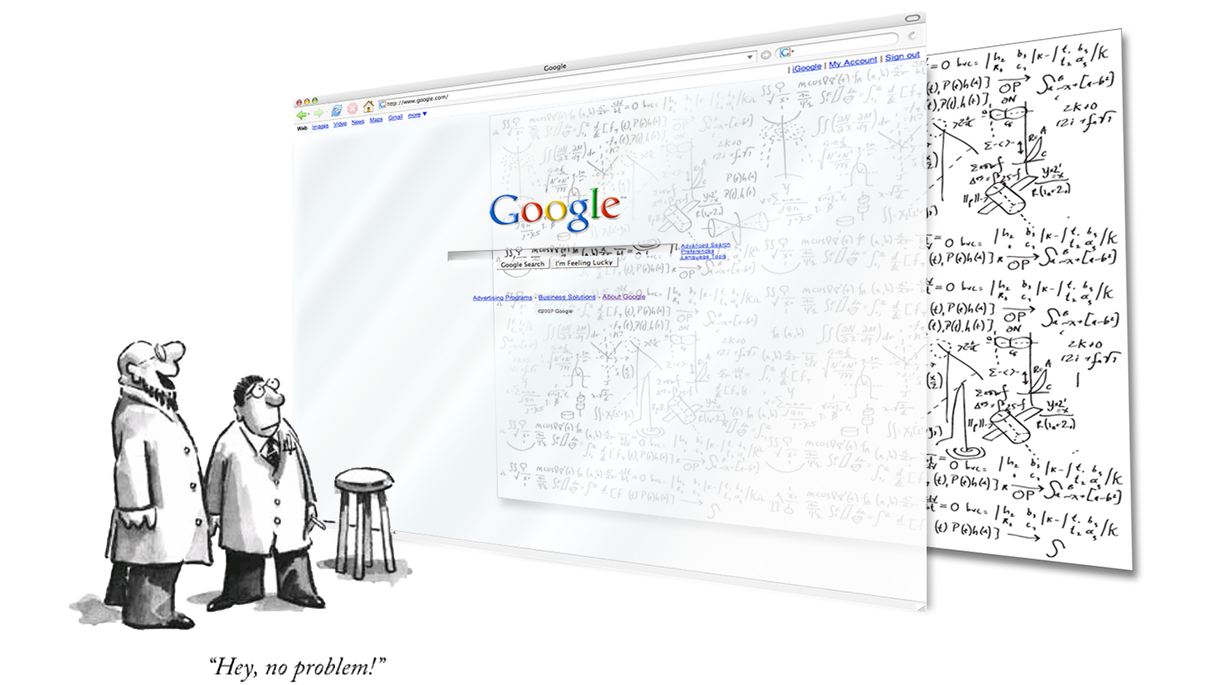
To make search easy is a (very) hard problem
Notes:
Story is about Instant Search

Slide 11
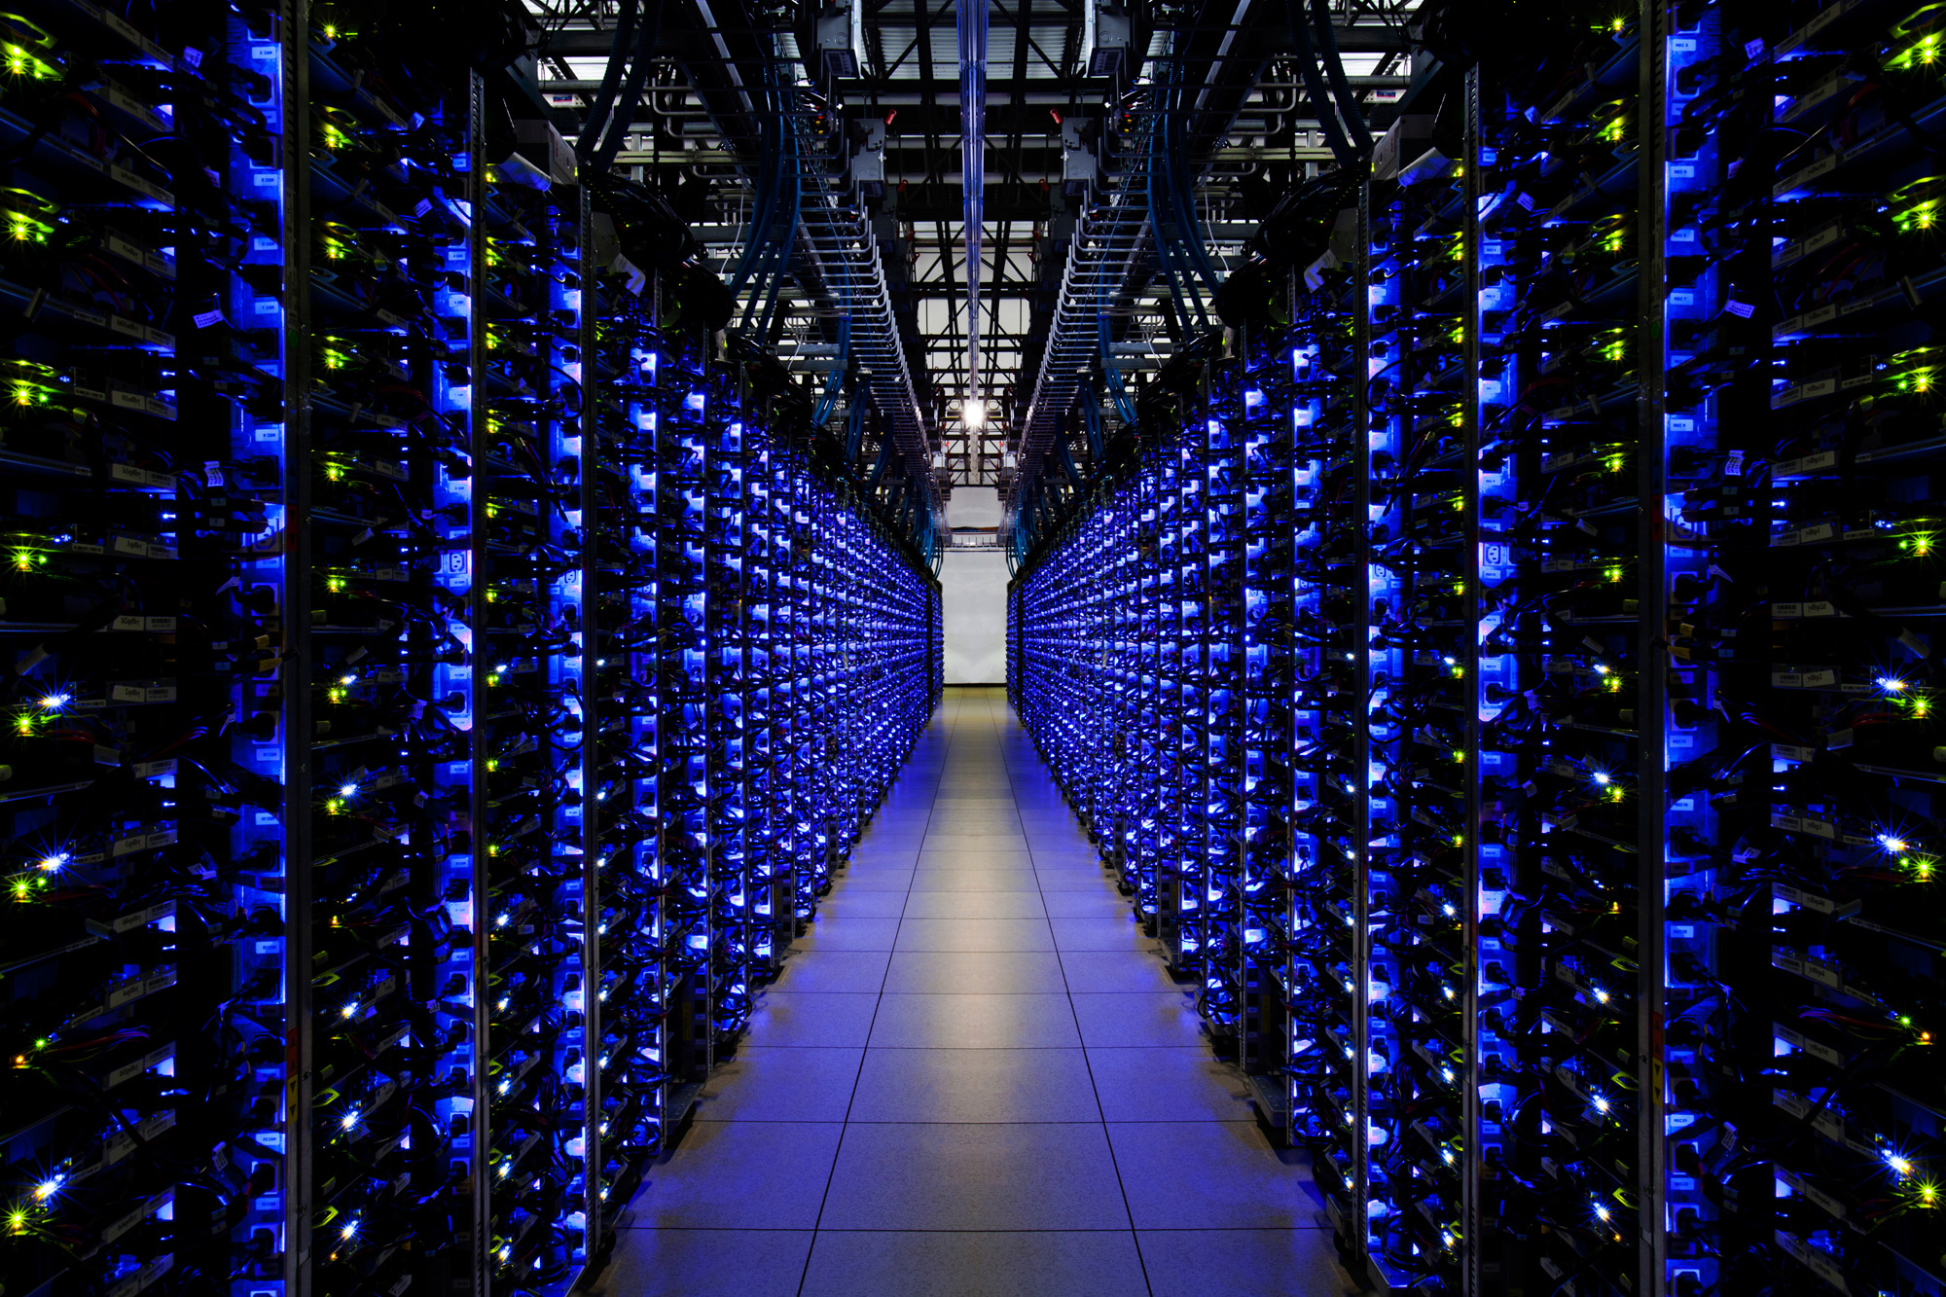
Notes:
We have lots of servers…. lots. Unfortunately it’s a closely guarded secret how many servers we have for obvious reasons, but according to a Google search I did last night, in 2008 we installed our millionth server.
Here are a few of them, looks like about 1000 just in this picture.

Slide 12
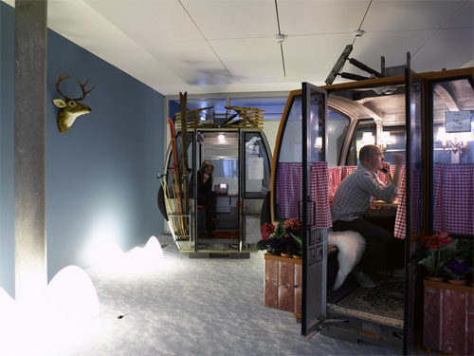
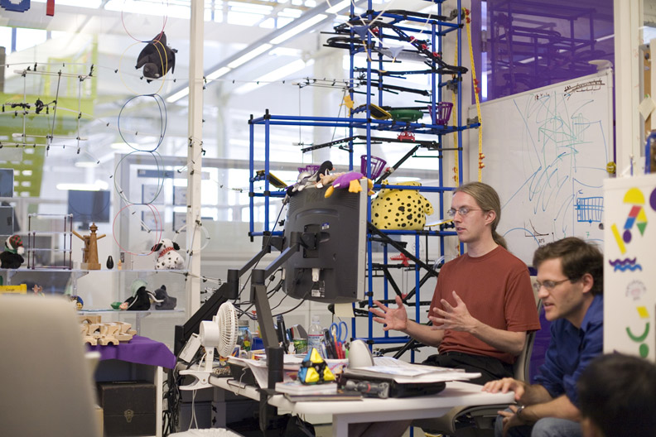
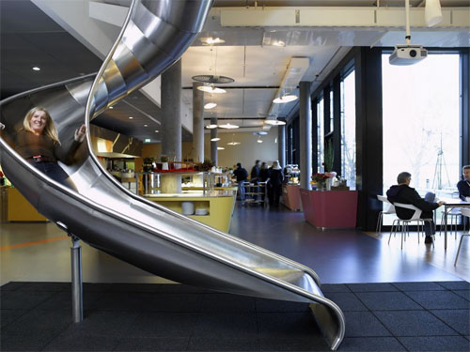
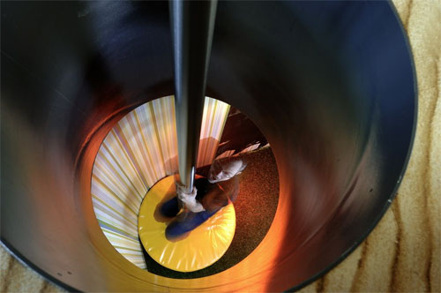
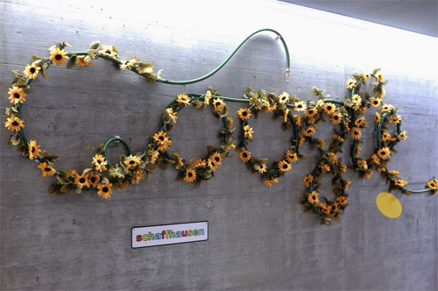
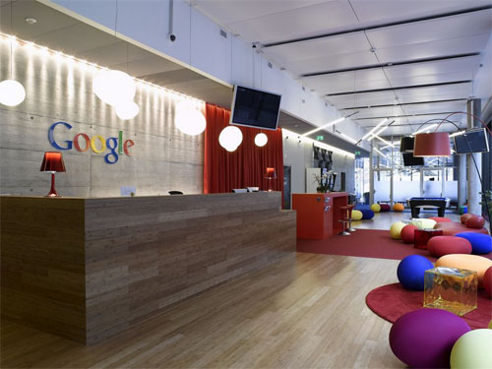
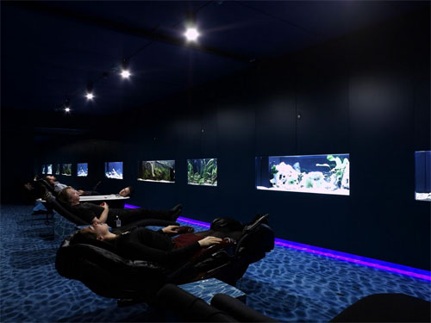
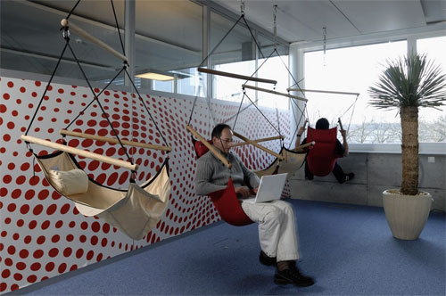
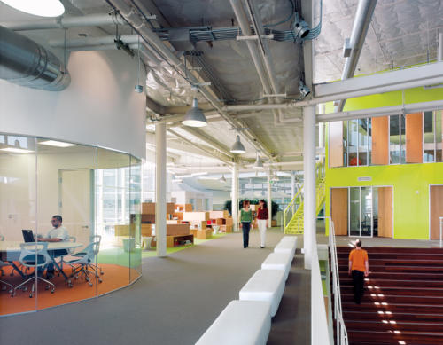
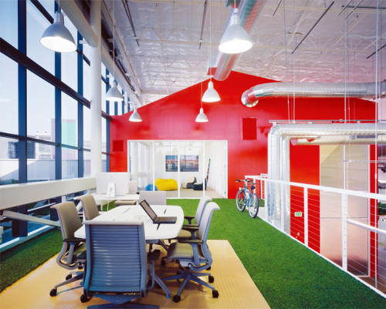
Notes:
Everyone contributed to ideas for new office space
No offices
Games rooms
Massage
Free Food

Slide 14
What’s Logo?
Google Confidential and Proprietary

Slide 15
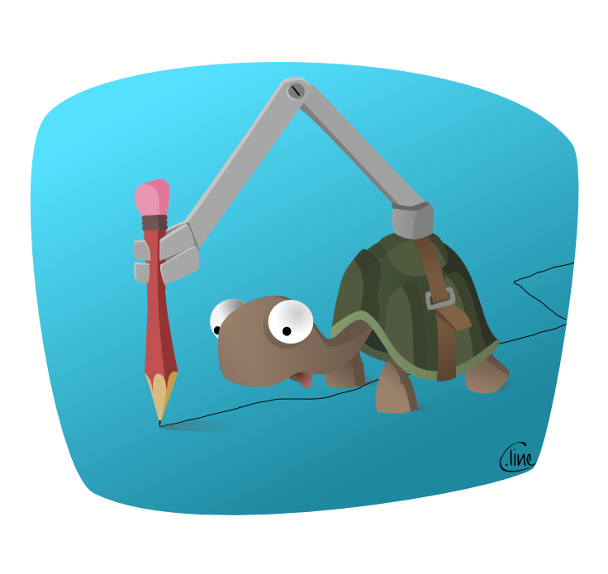
Turtle Graphics
Lubna Sorour

Slide 19
FORWARD 15

Slide 20
FORWARD 15
RIGHT 90

Slide 21
FORWARD 15
RIGHT 90
FORWARD 15

Slide 22
We’re going to learn 3 things today
How to draw pretty pictures
How to save lots of typing
If we’re quick, the three building blocks of programming:
Looping – doing the same thing lots of times
Variables – saving values that we want to use elsewhere
Functions – several lines of code we want to use again & again
Note : Functions are sometimes called Procedures or Methods.
This is going to be a quick run through – don’t be worried if you don’t understand everything today!

Slide 23
Basic Logo Commands
FORWARD - followed by the number of steps
BACKWARD - followed by the number of steps
RIGHT - followed by the angle of rotation
LEFT - followed by the angle of rotation

Slide 24
Basic Logo Commands
FD
LT
RT
BK

Slide 25
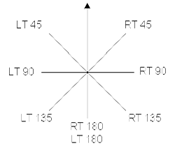
Turning around

Slide 26
FD 50
PU
FD 50
PD
FD 50
Huh!!!

Slide 27
PU = PenUp
PD = PenDown

Slide 28
Let’s get started…
Google Confidential and Proprietary

Slide 29
http://www.mikewarriner.com/jslogo
Or use LOGO on your desktops

Slide 30
Task – draw some pictures
SQUARE
FD 100
RT 90
FD 100
RT 90
FD 100
RT 90
FD 100
TRIANGLE
FD 100
RT 120
FD 100
RT 120
FD 100
HEXAGON
FD 100
RT 60
FD 100
RT 60
FD 100
RT 60
FD 100
RT 60
FD 100
RT 60
FD 100
PENTAGON
FD 100
RT 72
FD 100
RT 72
FD 100
RT 72
FD 100
RT 72
FD 100
HINT : type CLEARSCREEN before each picture to clear the screen and bring the turtle back home

Slide 31
LOOPS
Think of a loop as a way to save typing.
REPEAT 4 [FD 100 RT 90]
Notes:
A loop is a sequence of statements which is specified once but which may be carried out several times in succession. The code "inside" the loop (the body of the loop, shown below as xxx) is obeyed a specified number of times, or once for each of a collection of items, or until some condition is met, or indefinitely.

Slide 32
LOOPS
REPEAT 4 [FD 100 RT 90]
Basic structure is to tell Logo that you want to repeat something
REPEAT
Followed by the number of times you want to repeat it
REPEAT 3
Followed by the thing you want to repeat in square brackets
REPEAT 3 [FD 100 RT 90]

Slide 33
Task – try these using loops
SQUARE
FD 100
RT 90
TRIANGLE
FD 100
RT 120
HEXAGON
FD 100
RT 60
PENTAGON
FD 100
RT 72

Slide 34
Variables
Make "size random 500
Print :size
make – creates a variable with a value
"size– sets a variable called size
:size – gets the value of the variable called size
Try this now! Press Run lots of times and see what happens
Notes:
In computer programming, a variable or scalar is a storage location paired with an associated symbolic name (an identifier), which contains some known or unknown quantity or information referred to as a value. The variable name is the usual way to reference the stored value; this separation of name and content allows the name to be used independently of the exact information it represents. The identifier in computer source code can be bound to a value during run time, and the value of the variable may thus change during the course of program execution.

Slide 35
Adding things to Logo - Functions
Function save typing… even more typing than loops:
TO star
REPEAT 5 [FD 50 RT 144]
END
star
Notes:
In computer programming, a subroutine is a sequence of program instructions that perform a specific task, packaged as a unit. This unit can then be used in programs wherever that particular task should be performed. Subprograms may be defined within programs, or separately in libraries that can be used by multiple programs.
In different programming languages a subroutine may be called a procedure, a function, a routine, a method, or a subprogram. The generic term callable unit is sometimes used.[1]

Slide 36
Adding things to Logo - Functions
Function save typing… LOTS of typing…
TO star
REPEAT 5 [FD 50 RT 144]
END
star
Notes:
In computer programming, a subroutine is a sequence of program instructions that perform a specific task, packaged as a unit. This unit can then be used in programs wherever that particular task should be performed. Subprograms may be defined within programs, or separately in libraries that can be used by multiple programs.
In different programming languages a subroutine may be called a procedure, a function, a routine, a method, or a subprogram. The generic term callable unit is sometimes used.[1]

Slide 37
Adding things to Logo – Variables in functions
TO randomstar
make "size 50 + random 500
REPEAT 5 [FD :size RT 144]
END
clearscreen
randomstar
make – creates a variable with a value
"size– sets a variable called size
:size – gets the value of the variable called size
Notes:
Add window to stop it wrapping around

Slide 38
Adding things to Logo - Parameters
TO square :size
REPEAT 4 [FD :size RT 90]
END
Clearscreen
Repeat 36 [square 100 rt 10]

Slide 39
Recap on what we learnt…
How to draw pretty pictures
How to save lots of typing
Looping – doing the same thing lots of times
Functions – several lines of code we want to use again & again
Note : Functions are sometimes called Procedures or Methods.
Variables – saving values that we want to use elsewhere

Slide 40
Where next?
http://www.mikewarriner.com/jslogo
- Online LOGO interpreter you can play with at home
http://www.mikewarriner.com/docs
- This document and others
http://turtleacademy.com/
- A good learning resource for Logo to go to next. Uses the same online interpreter above.

Slide 41
Out of time! Thanks for listening.
Google Confidential and Proprietary

